Slide 1
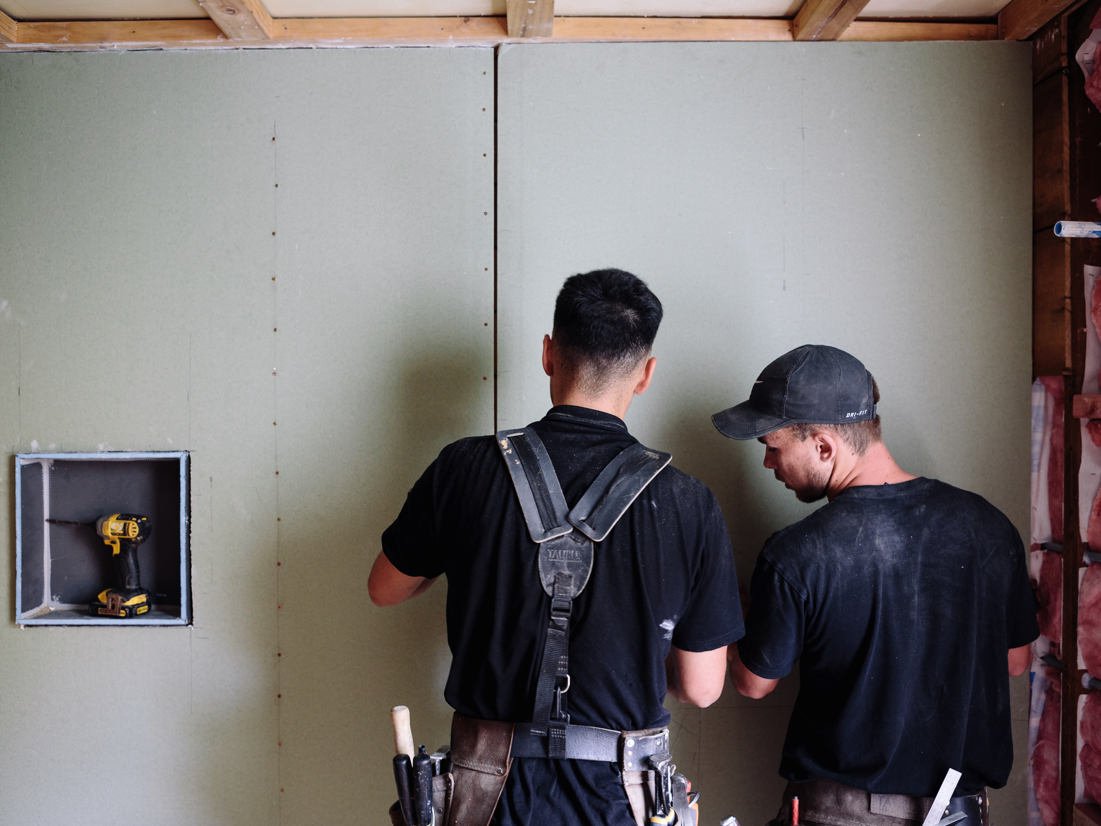

GIB® - Systems to Achieve Better Living Environments

Slide 2
Contents
Thermal efficiency through GIBFix® framing systems
Rigid Air Barriers (GIB Weatherline®)
BRANZ testing and appraisals
Upgrades vs Substitutions

Slide 3




Technical Support Team
      HELPLINE
- Calls 80 + /day - Emails 20+ /day
-400 /week (avg)
      Training
        Internal
        External
        - LBP Events
        - LBP Training Days (Merchants)
      Support
        Technical
        Marketing
      Research and development

Slide 4
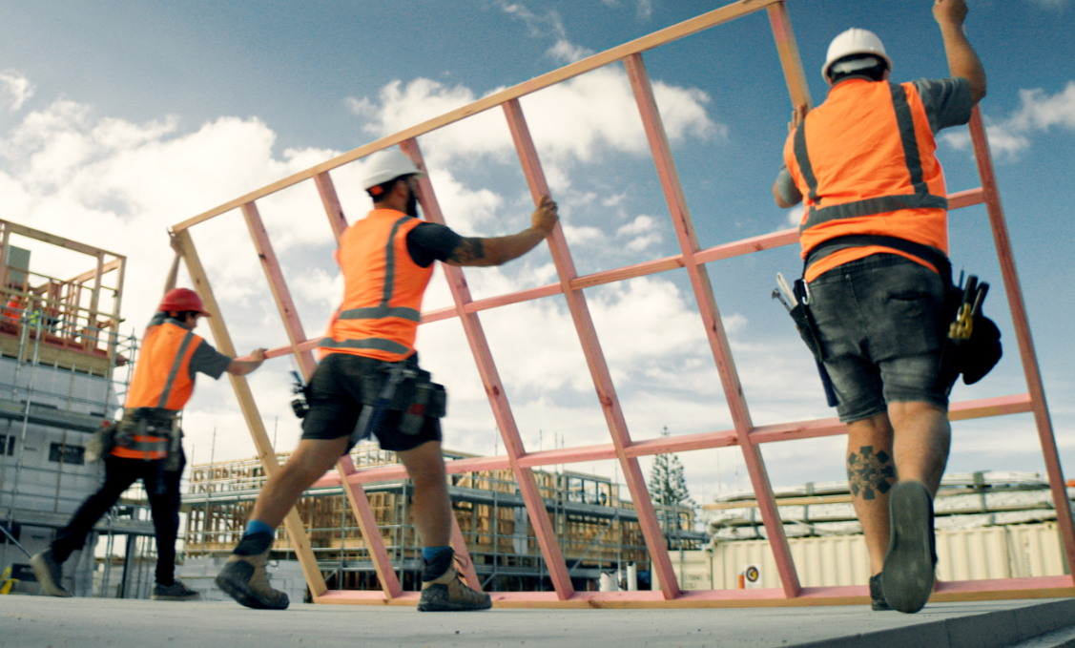
Framing for NZ Housing
BRANZ in conjunction with Beacon Pathway Inc. study and report (July 2021) – covering 47 dwellings
Most residential construction is with built with timber framing – 90% by F&T
The average percentage of timber framing compared to the area of the wall is 34%
Lowest 24% – highest 57% (by level)
Range of drivers –structure and weathertightness, cladding requirements, design, preference
Little additional framing added on site – average across house level = 2%
There are some significant uninsulated areas – average 3% but up to 10% (area by level)

Slide 5
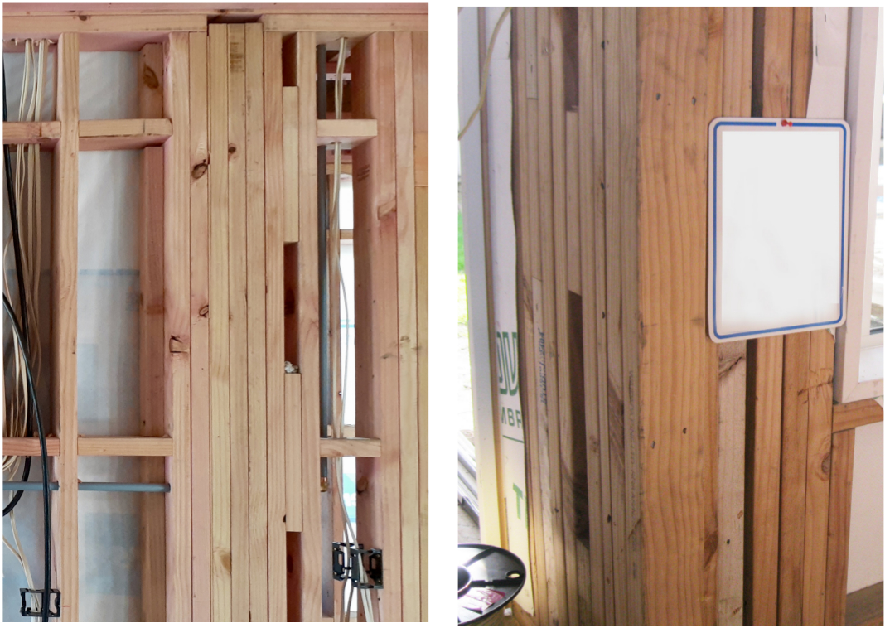
Framing for NZ Housing

Slide 6
Framing for NZ Housing
34% average of wall framing … higher than 14–20% framing content generally assumed by regulators and industry
Unlikely to be meeting expected performance across the whole wall
R-2.8 is the highest practicable R-value of common insulation materials that can be used with 90mm studs
Weak points and blind spots, i.e, corners, unreachable voids and junctions

Slide 7
Corner leakage

Slide 8
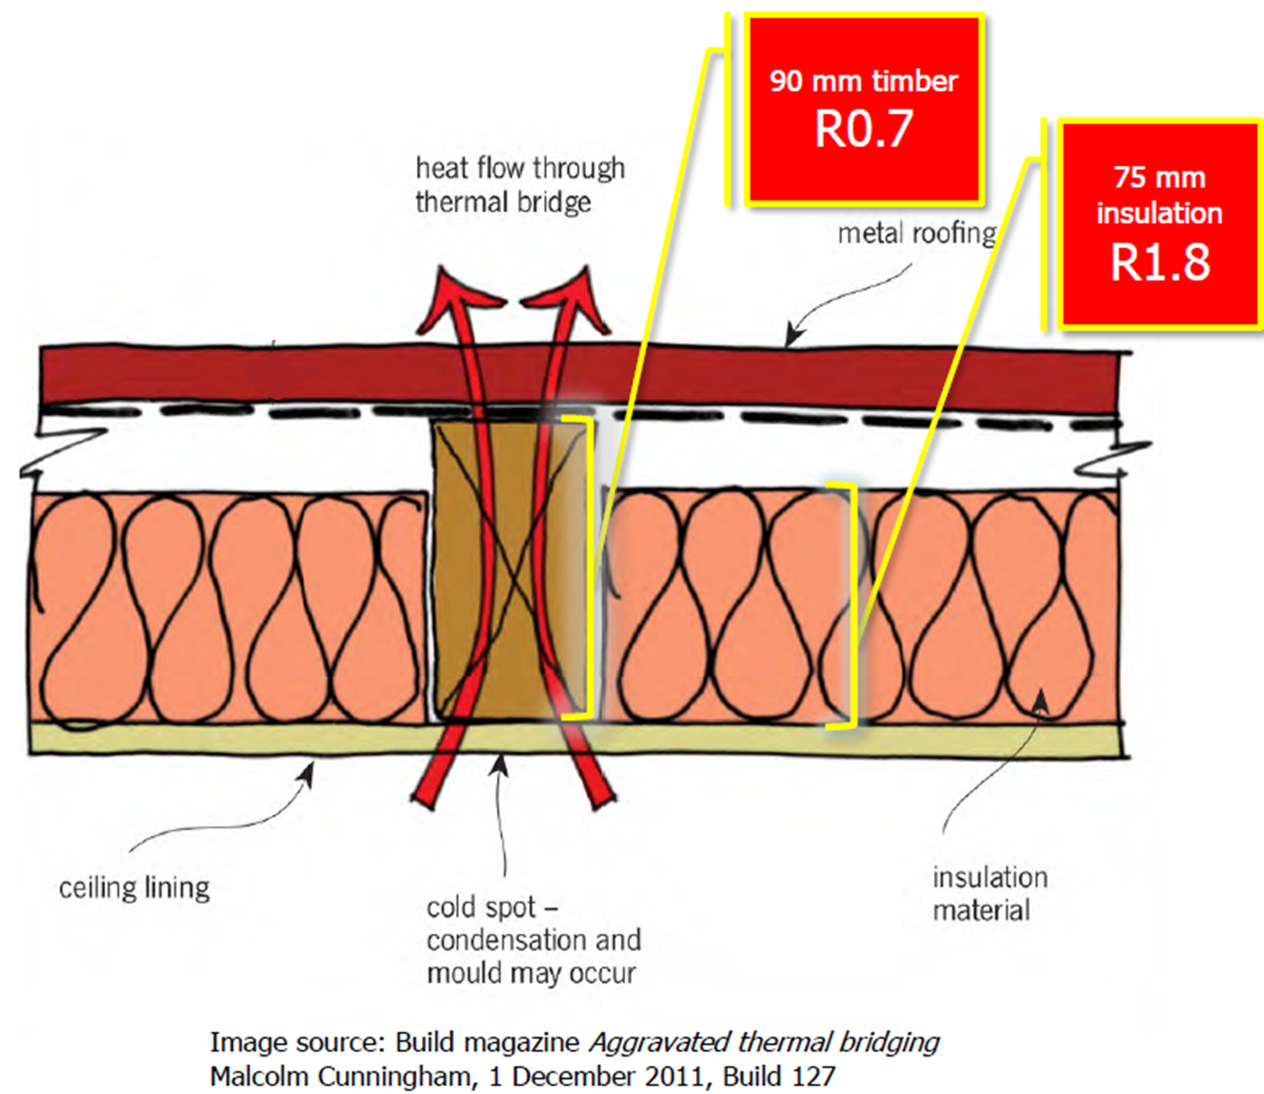
Not that great…

Slide 9
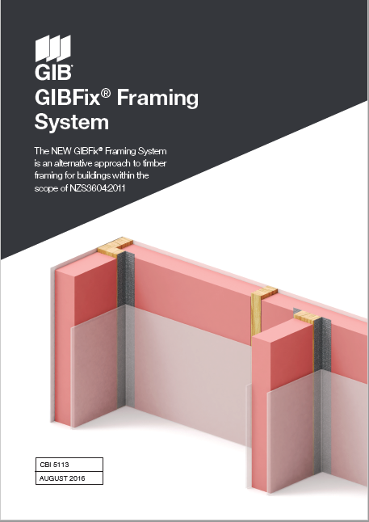
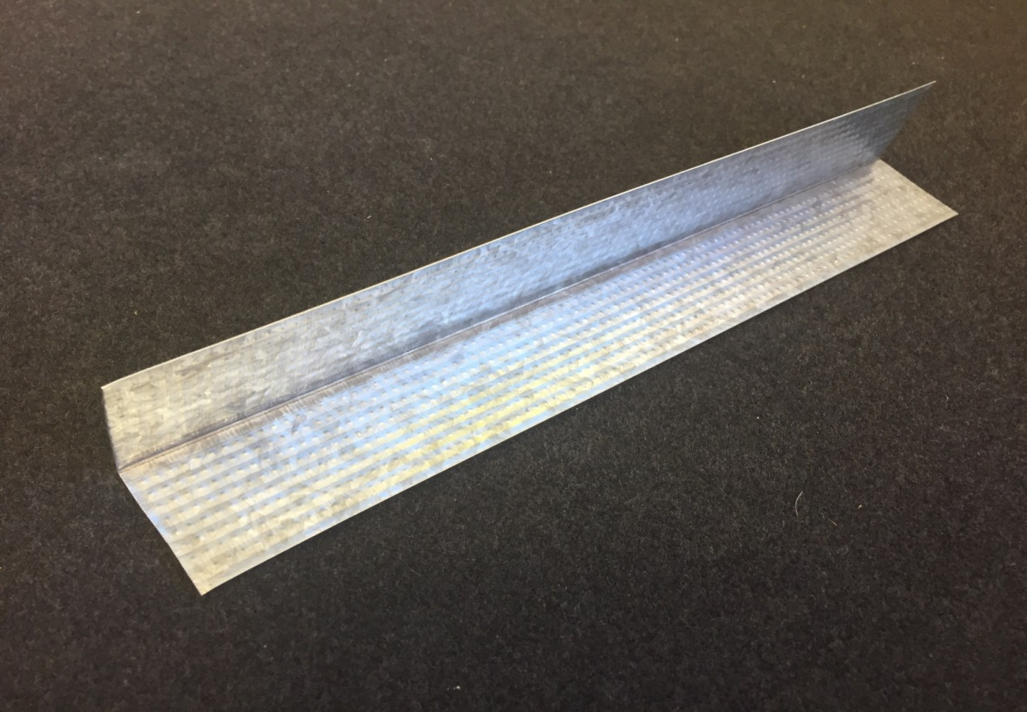
What are GIBFix® Framing Systems?
45x45mm .55 BMT Steel Angle
Dimples for ease of screw insertion

Slide 10

Framing for NZ Housing - GIBFix® Framing

Slide 11
Framing for NZ Housing - GIBFix® Framing
Specified at design stage
Frame and Truss manufacturers are familiar with the systems
Not much changes for the builders on site, no specialist trades required
Incorporates GIB Ezybrace® systems including approved GIB Handibrac® locations
The GIBFix® Framing System is an alternative approach to timber framing for buildings within the scope of NZS3604:2011

Slide 12
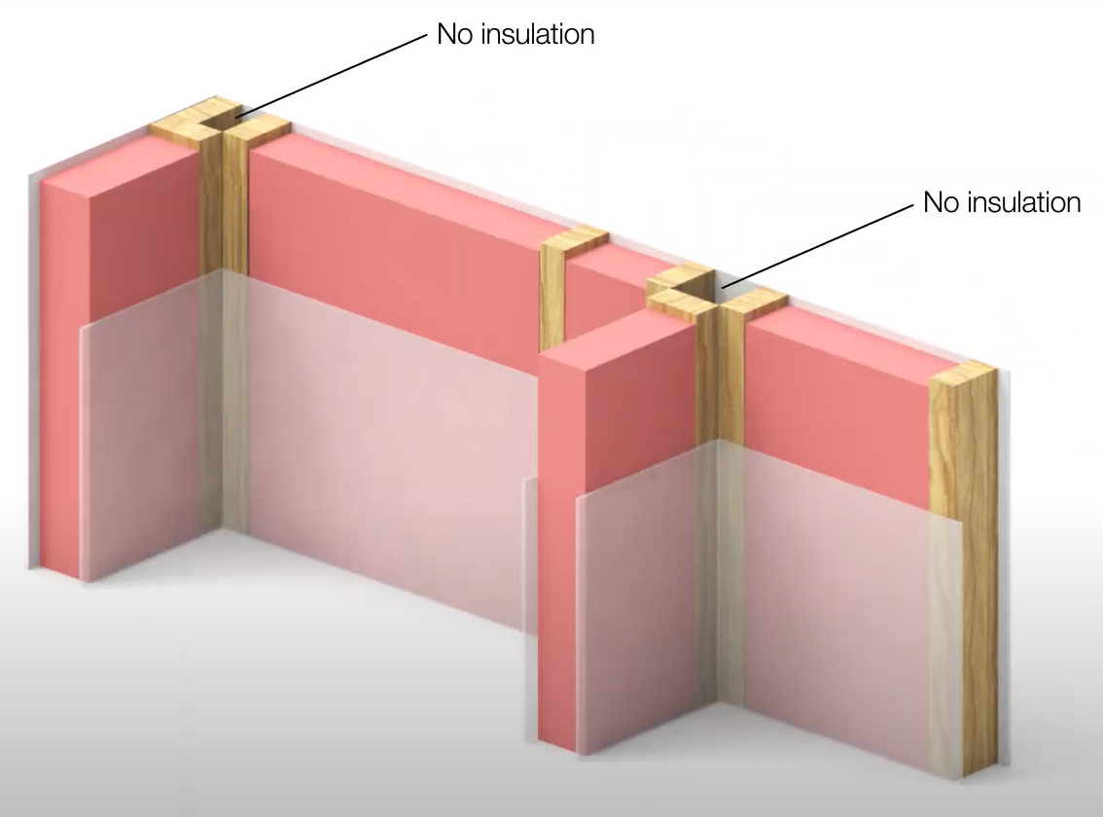
GIBFix® Framing Systems?

Slide 13
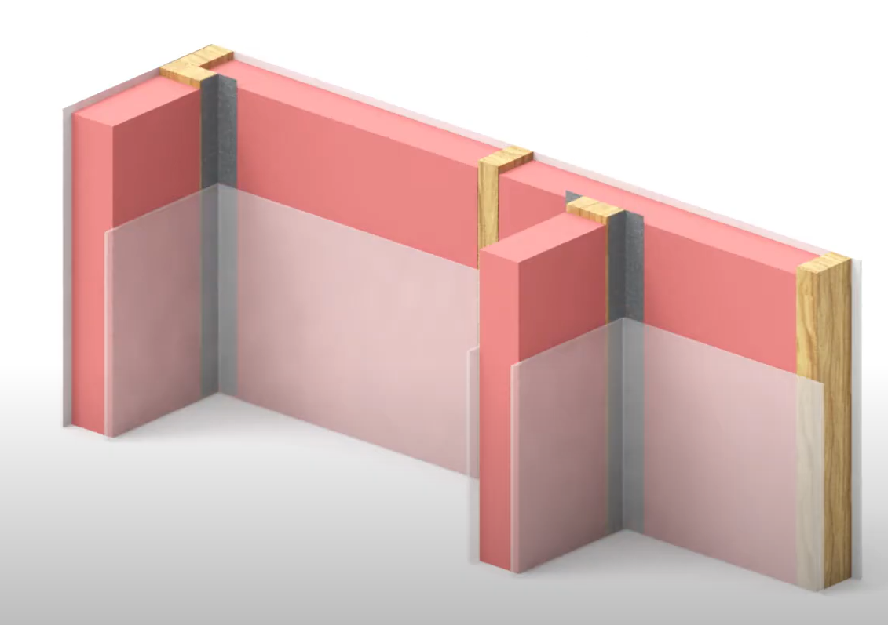
GIBFix® Framing Systems?

Slide 14
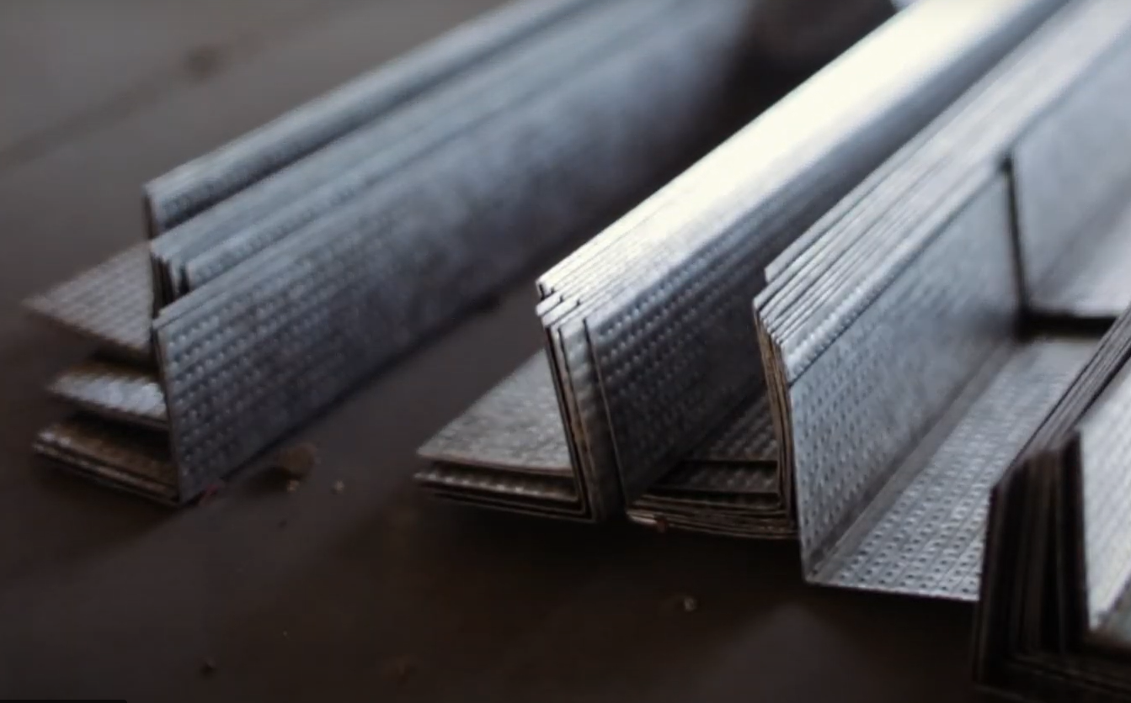
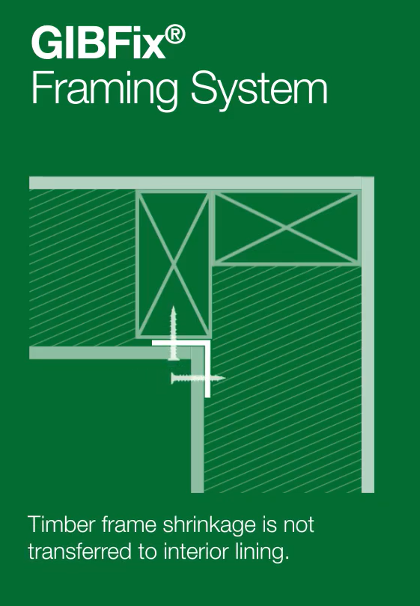
GIBFix® angle

Slide 15
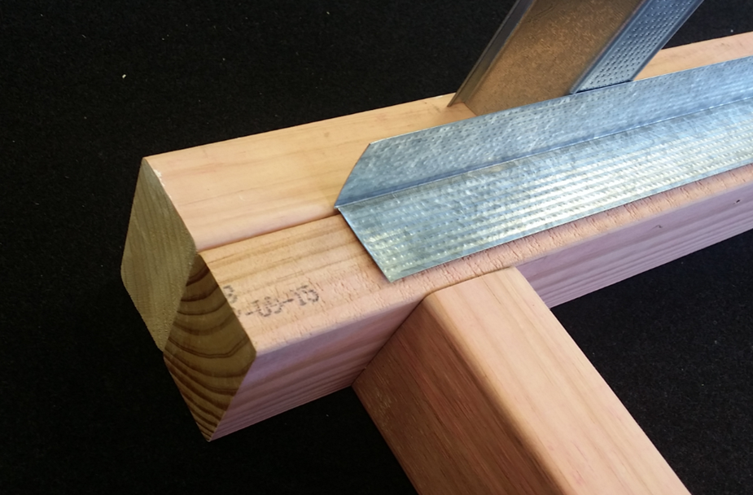
Incorporating the use of metal components?

Slide 16
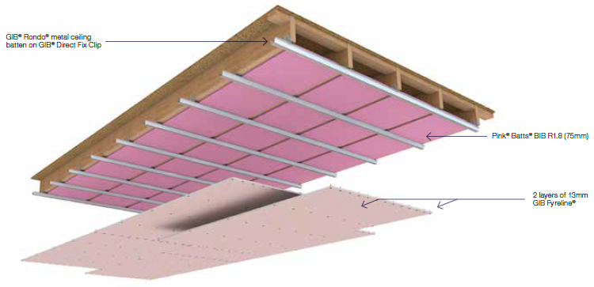
GIB® Rondo® Ceilings

Slide 17
Framing for NZ Housing
Research Report - Thermal Bridging in External Walls: Stage Two (ER64 [2021] Project LR12322)
The study showed “..we thought this method (GIBFix® Framing) would be widely adopted and become the new normal as it provides better performance and is cost neutral. Unfortunately, these techniques have not been widely adopted. Therefore, for the reasons stated above it may be a good example to become a new acceptable solution…”
An achievable 3% reduction in timber

Slide 18
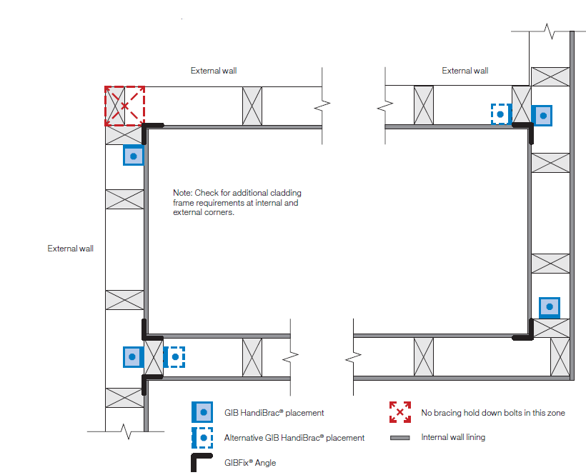
GIB Ezybrace® Systems and GIB Handibrac®
Where 2 bracing elements meet on the same stud you only need 1 GIB Handibrac®

Slide 19
Limitations…
Fire systems
  Some 2-way fire systems require “solid blocking” for sheet edge/perimeter fixing
Tiled walls
  Weight bearing capacity needs to be checked
Load Bearing and Brace walls
  top plate connections need to be considered

Slide 20
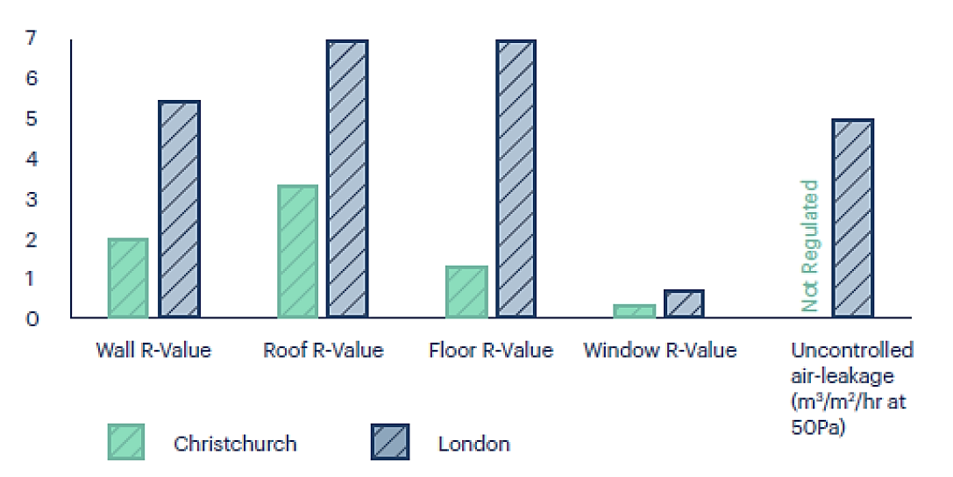

Insulation & Air-Tightness Requirements (Chch vs London)
Notes:
Some of it will be easy.
Look at this simple comparison between the insulation and air tightness requirements of Christchurch and London.

Slide 21
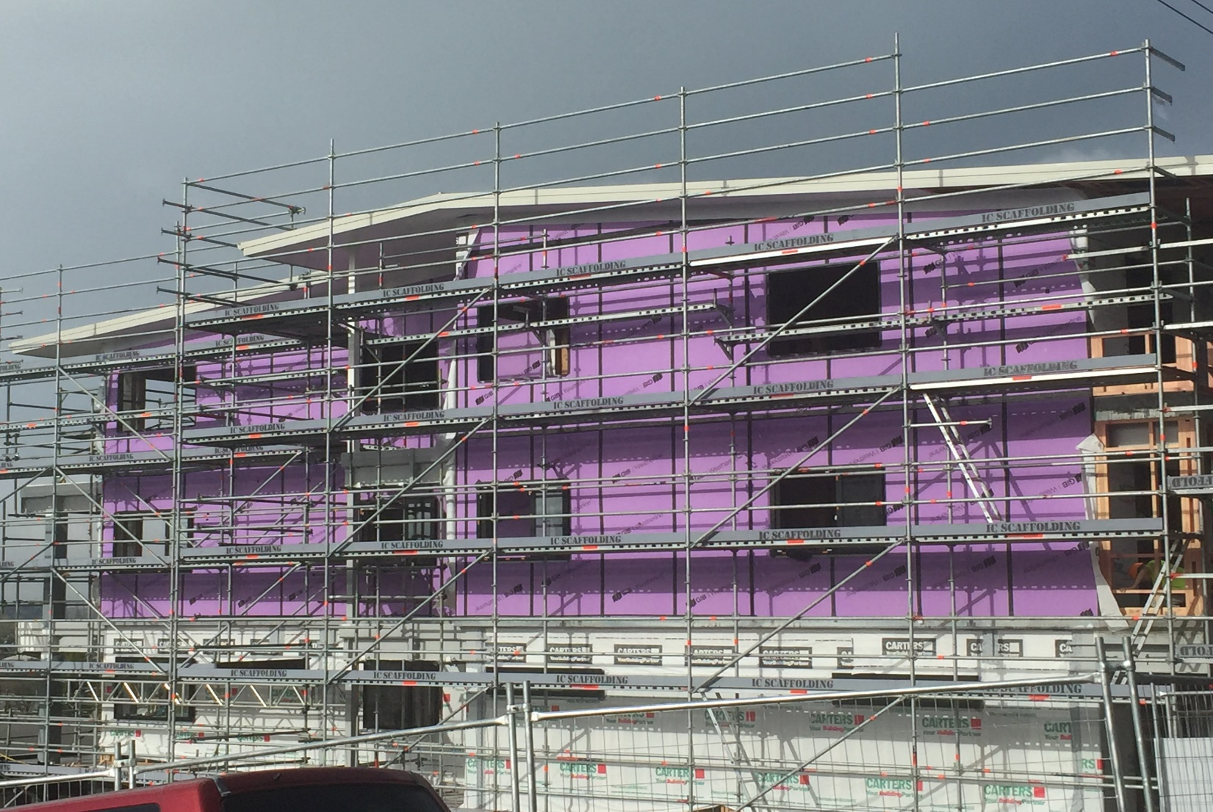
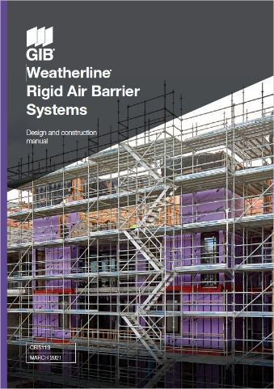


GIB Weatherline®

Slide 22
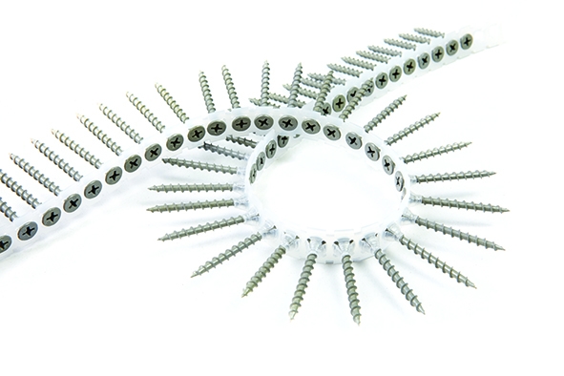
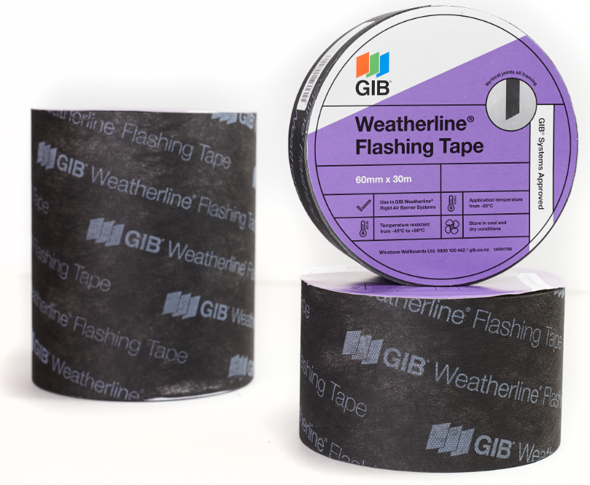

GIB Weatherline®
GIB Weatherline® sheets have a highly modified gypsum core with a fibreglass faced fleece front and back
GIB Weatherline® Ceramic Coated Fasteners
GIB Weatherline® Flashing and Sill Tapes
Early close in (180 days)
  Dry buildings and timber out
Only 0.2 R-value
Excellent thermal break (conductivity)
Prevents air leakage
  Provides opportunity to control environments

Slide 23

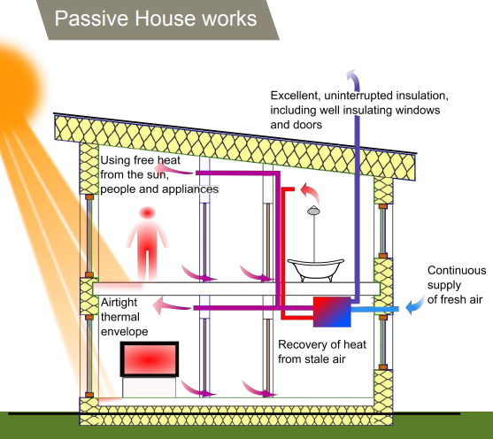
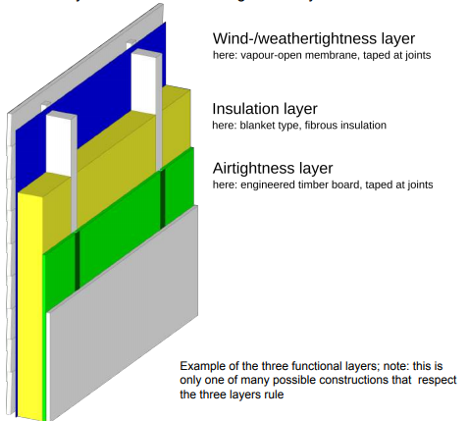
‘Passive House’ (An Environmental Building Standard)
Rating Tool Rates whole Buildings (not just components)
Air Tightness
Layer
The Passive House standard is first and foremost about a comfortable, well­ ventilated home that needs very little energy. .
Notes:
With Passive homes The idea is to construct buildings that are healthy and comfortable year-round, while needing very little energy to operate.
A quality assurance regime starts with the design and ends with an as-built certification.
While certified Passive Houses differ significantly in appearance and typology, they all perform within a narrow band of performance indicators:
An annual heating/cooling demand of not more than 15 kWh/m² per year OR a peak heat load of 10 W/m². interestingly, this is the target and will be requirement for NZ homes under the Building for Climate change programme, operational efficiency.
There must not be more than 0.6 air changes per hour at an indoor/outdoor pressure difference of 50 Pa during a test.
A feature is a very efficient hat exchanger in the ventilation system which recovers about 85% of the heat in the air being exhausted and transfers it back into the incoming air.
In addition, there are limitations for primary energy renewable demand and, for some certification classes, also requirements to generate renewable energy on site.

Slide 24
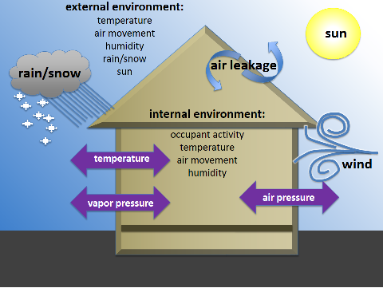
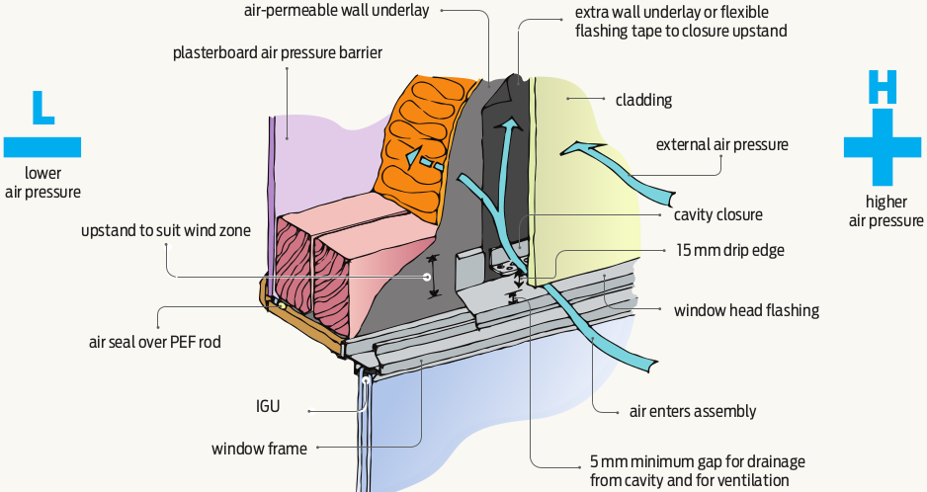
Air Pressure and Vapour Control

Slide 25

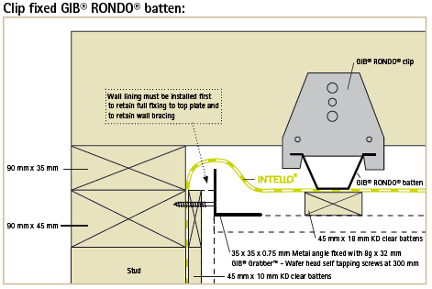
“Passive House”

Slide 26
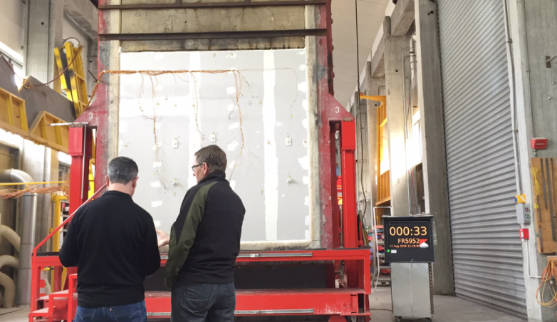
BRANZ Testing
On site testing in Wellington and Auckland University
Record and physical sample of system components that make up the specimen
  Future reference
  Proof
Choice of materials and brand are very important

Slide 27


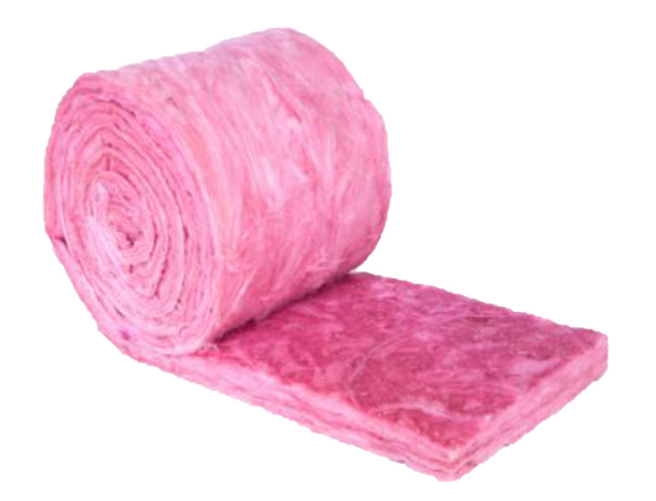

Why Pink® Batts®
Own BRANZ appraisal
Proven history of performance and quality
Great product range
Made in NZ (just up the road)
Aligned interests (R&D)
  Acoustic performance
  Fire performance
  R-values

Slide 28

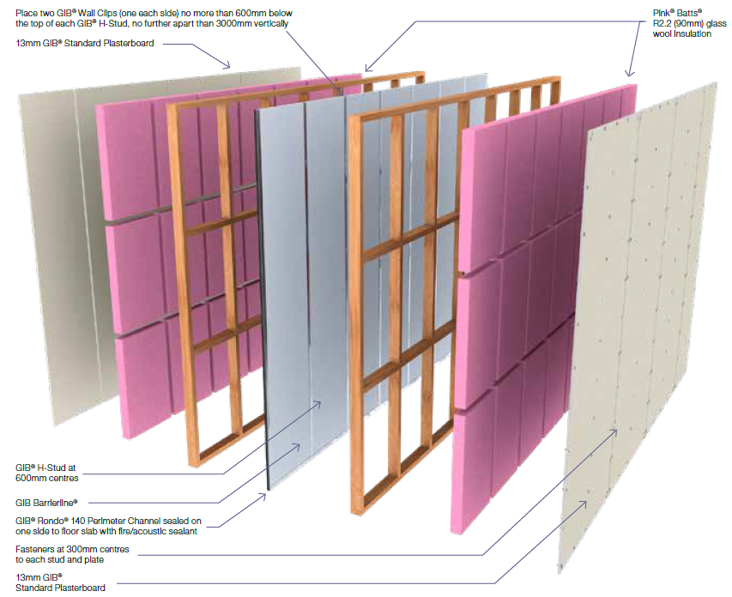

GIB® Systems using Pink® Batts®

Slide 29
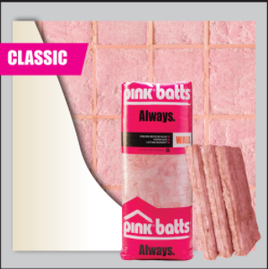
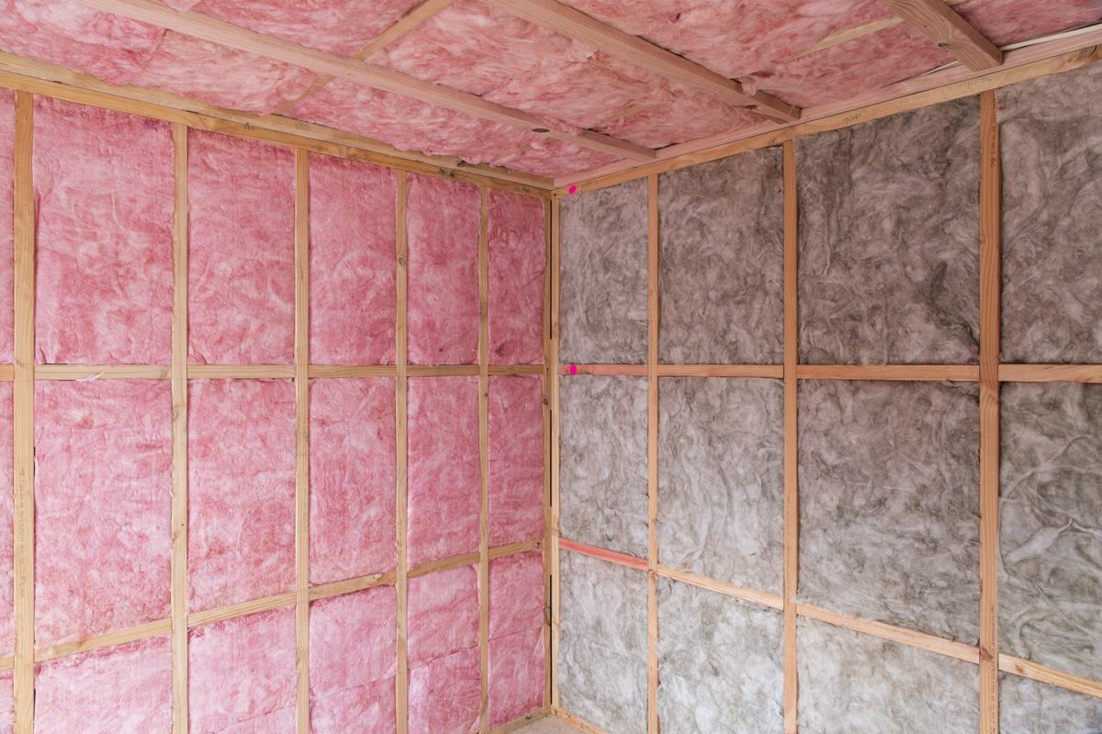
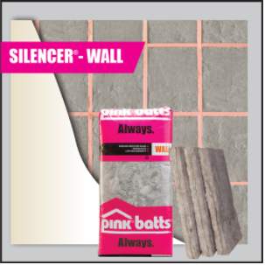
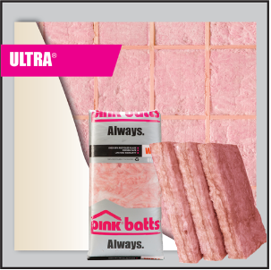
Upgrading?
“your system states R2.2, can I upgrade that to R2.4 or Silencer®?”
  As it is an “upgrade” there is no negative impact on the performance of the GIB® system, including the Silencer® and Ultra ranges (up to R2.8 in 90mm frame) is allowed.
Fire
Noise
Silencer® range is also included (even though it’s a different colour!)

Slide 30
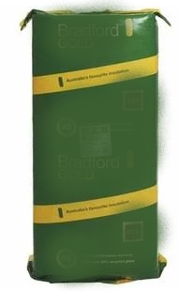


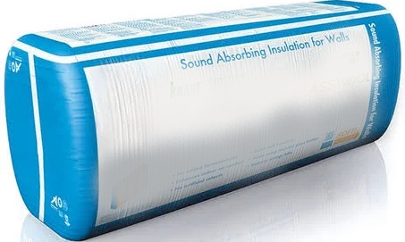
Upgrading vs Substitution
“what about another brand…?”
“if you choose to substitute a component in a tested system then the responsibility lies with YOU to provide proof it will perform to an equal or greater value”

Slide 31
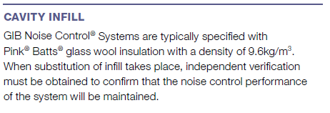
Upgrading vs Substitution
  *page 12 – GIB® Noise Control Systems - September 2017

