Slide 1
Overview and upcoming changes to NZBC clause H1.
Why change
The importance of getting insulation in
Potential H1 changes
Building for Climate Change
Whole house performance

Slide 2

World Health Organisation (WHO) Recommendations
WHO says to support healthy living we should, as a MINIMUM, have:
Inside temperature above 18ºC
Inside temperatures above 20°C for very young, old or ill people
Relative humidity less than 70%, ideally between 40% and 60%

Slide 3
Characteristics of New Zealand homes
COLD
A BRANZ Study (HEEP 2006) found that average night time temperatures during the three winter months were:
  17.8ºC in the living room
  13.6ºC in the bedroom
  DAMP
  A BRANZ Study (House Condition Survey 2015/16) found:
  43% of owned homes have visible signs of mould
  55% of rented homes have visible signs of mould

Slide 4
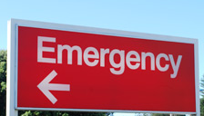

Our sad health Statistics
NZ has 1,600 excess winter deaths each year
NZ is fourth out of 36 OECD countries for asthma hospital admission rates
NZ has 160 cases of rheumatic fever a year,
high for a developed country (120 people die
of rheumatic heart disease a year)
One in ten hospital admissions are respiratory related
A 2015 estimate of the cost of respiratory disease to NZ was $7 billion (mortality, disability, hospitalisation, prescriptions and doctors' visits)
Credits: https://images.unsplash.com/photo-1586021280718-53fbadcb65a7
Notes:
VC notes
If need to explain “excess winter deaths” – means more people die in the winter than you’d expect from normal causes, so it is linked to colder conditions and poor housing
“OECD” – 37 countries in the world considered more developed…so you don’t want to be at top of their tables with poor health statistics…
a billion is a thousand million, so that $7b is a 7 with NINE zeros after it – a lot of money.
“the condition of our housing is in all of these statistics.. This national picture is the sum of some tough times for whānau in our homes…

Slide 5
NZ housing has a Role in Climate change
Residential demand for energy 10% of total
  (MBIE stats for 2018)
Homes use ~30% of NZ’s electricity
Winter and peak demand the biggest challenge for grid
  (Transpower)
These peaks demand fossil fuel burning (high C)
Operational energy is largest contribution of homes to residential emissions
Need efficient thermal envelope so people are warmer AND can reduce energy use.

Slide 6

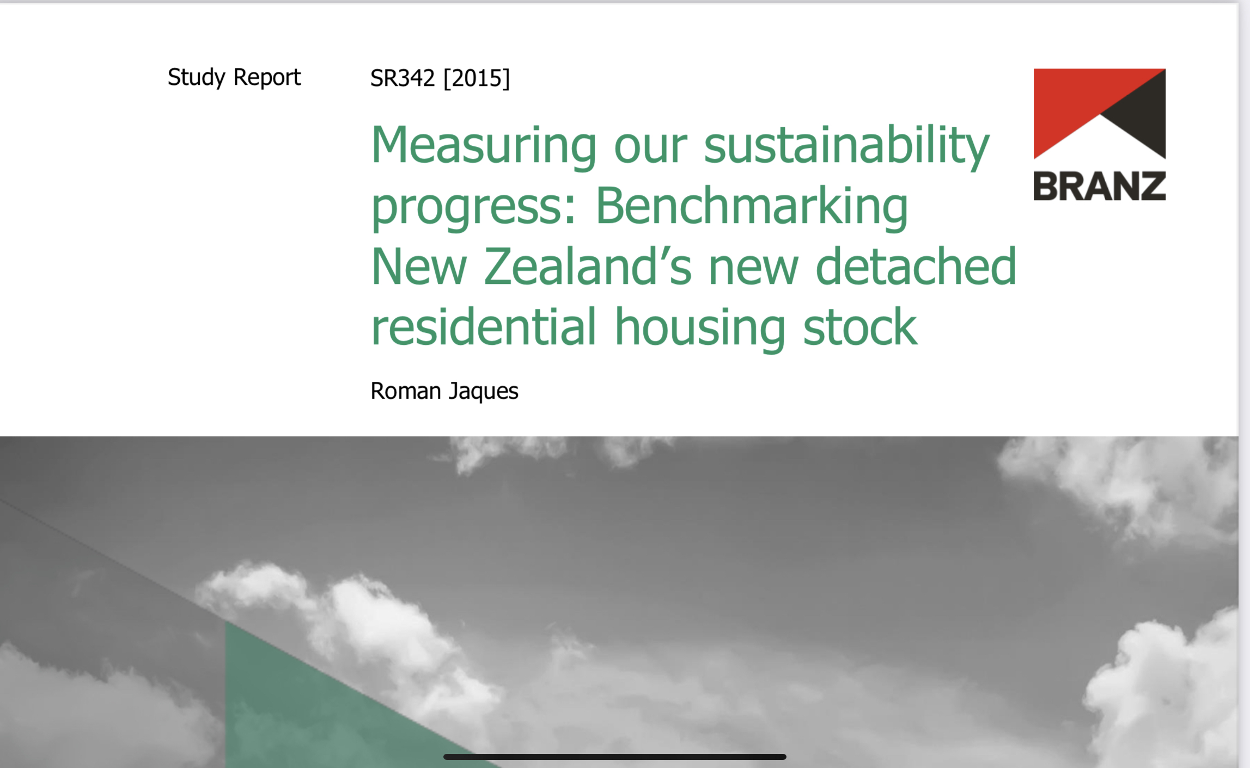

Slide 7
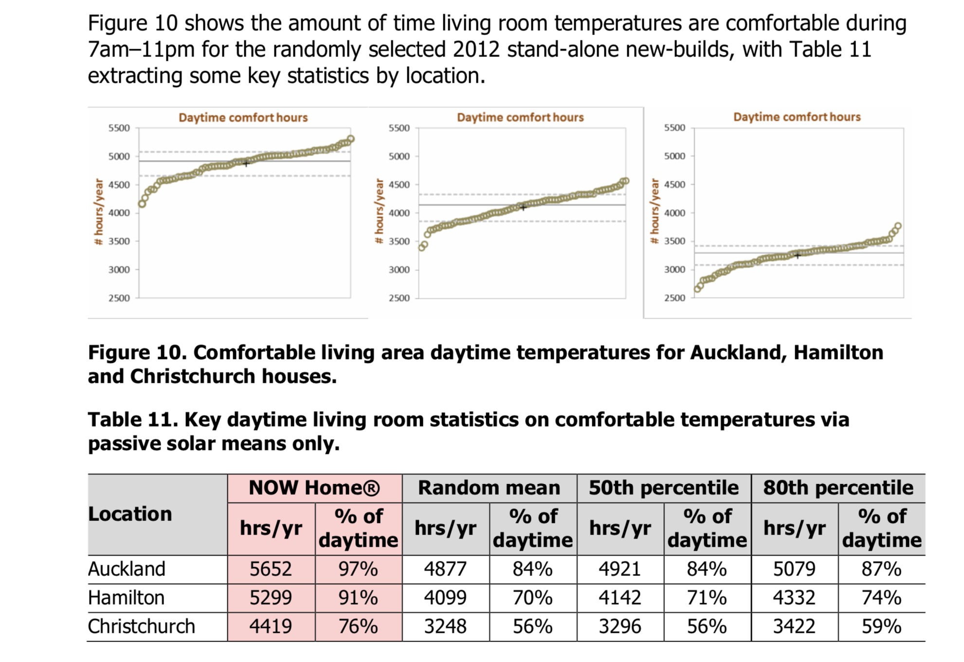

Slide 8
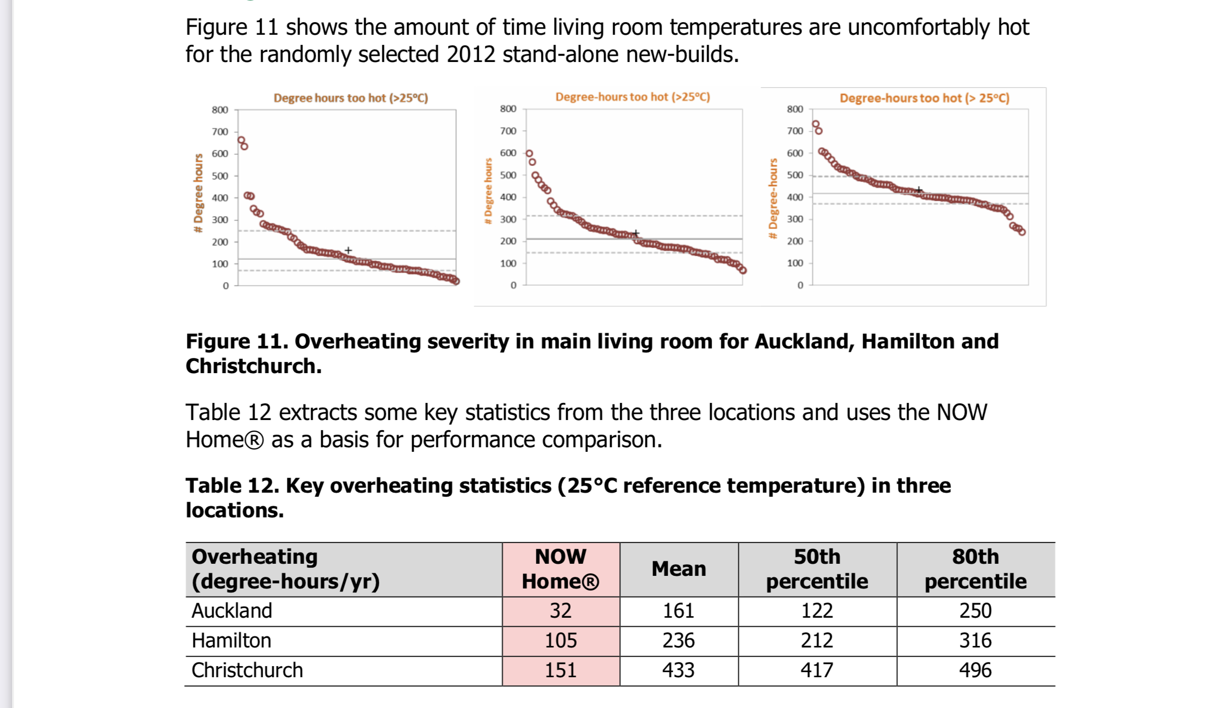

Slide 9
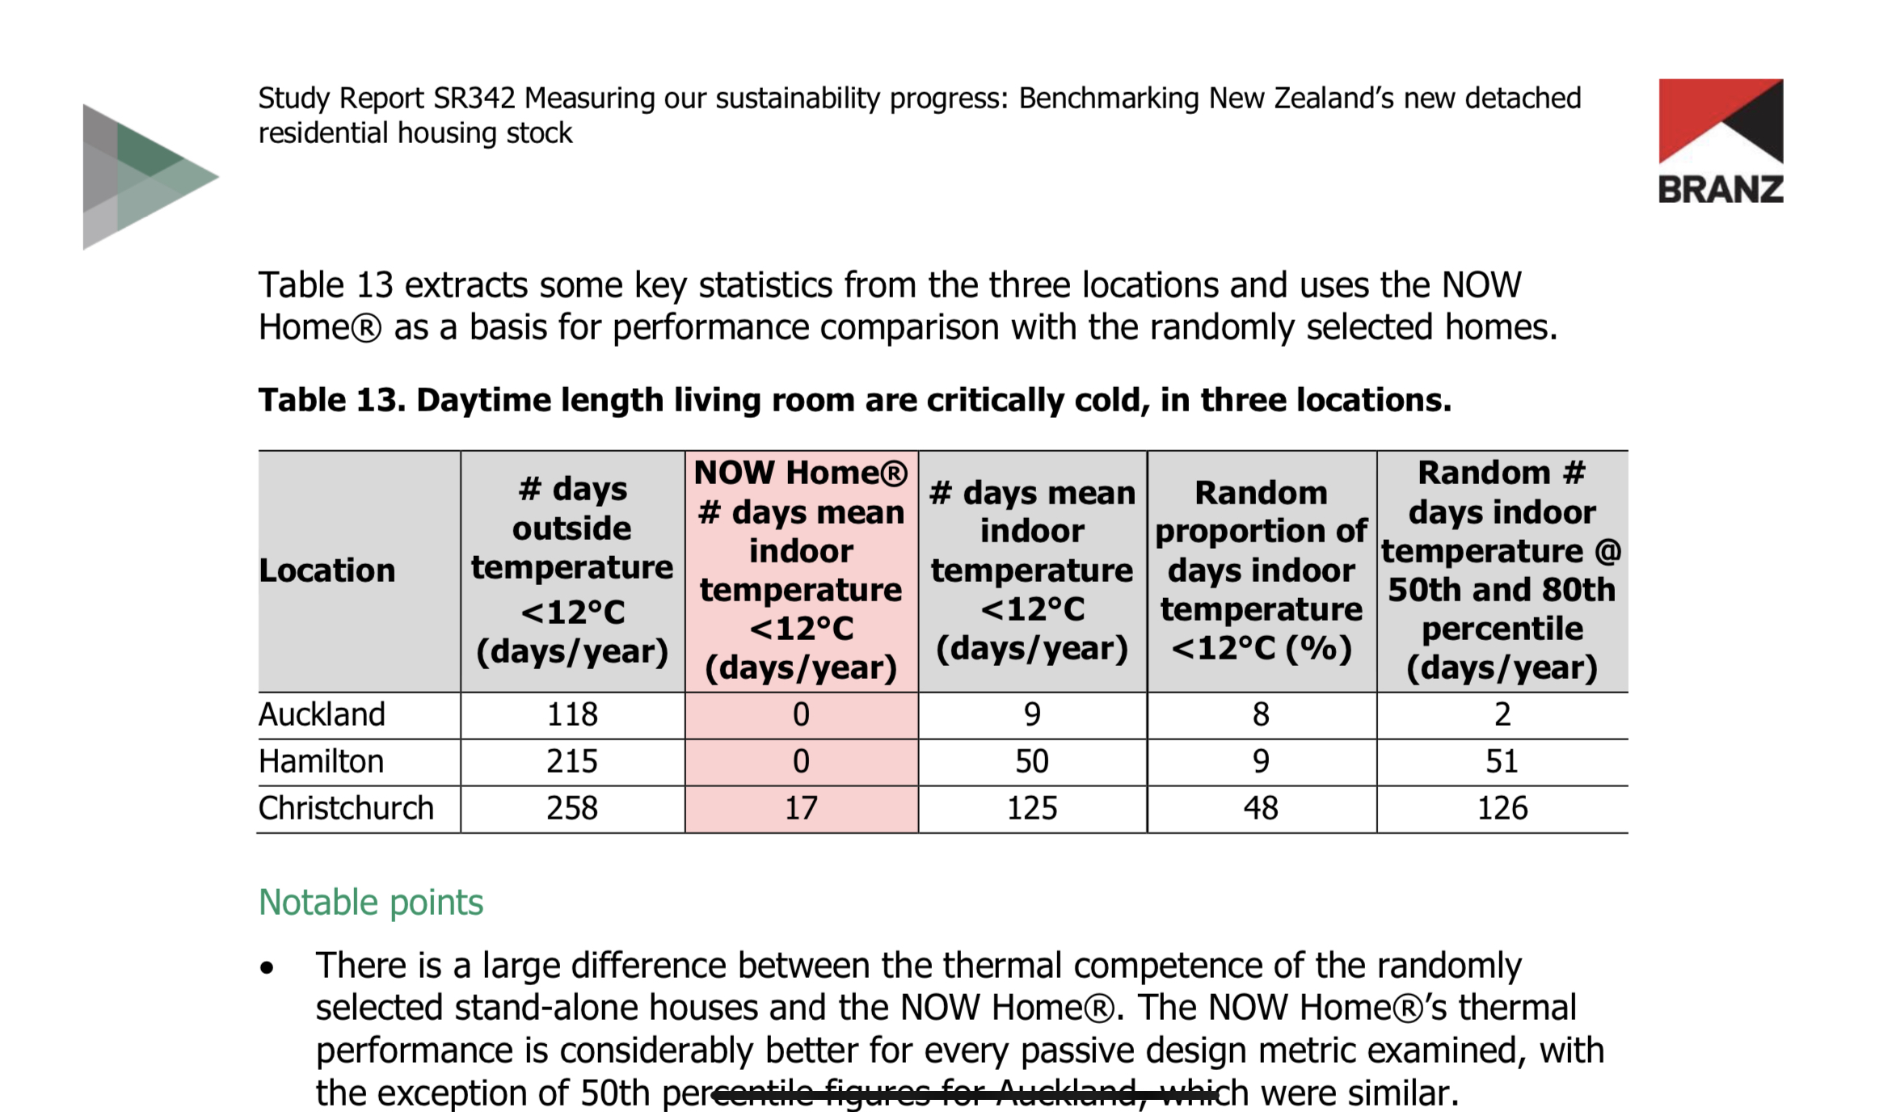

Slide 10
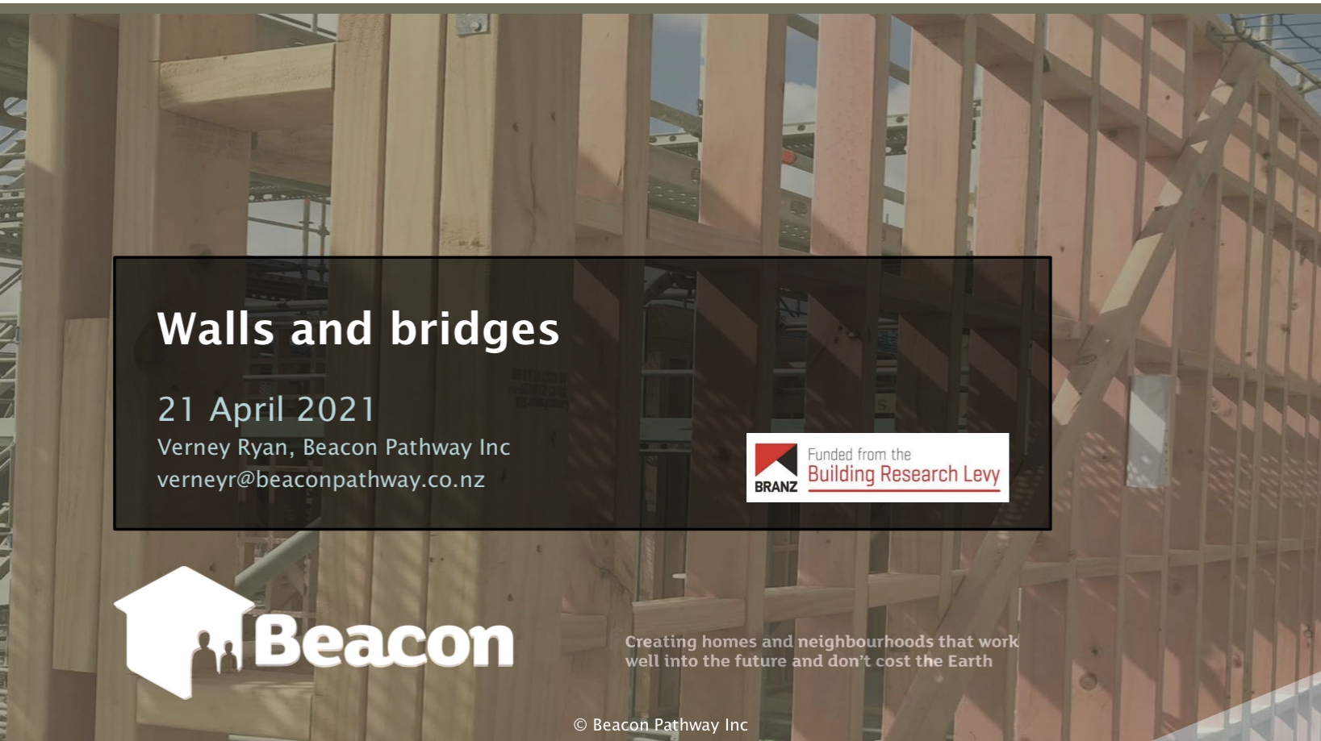

Slide 11
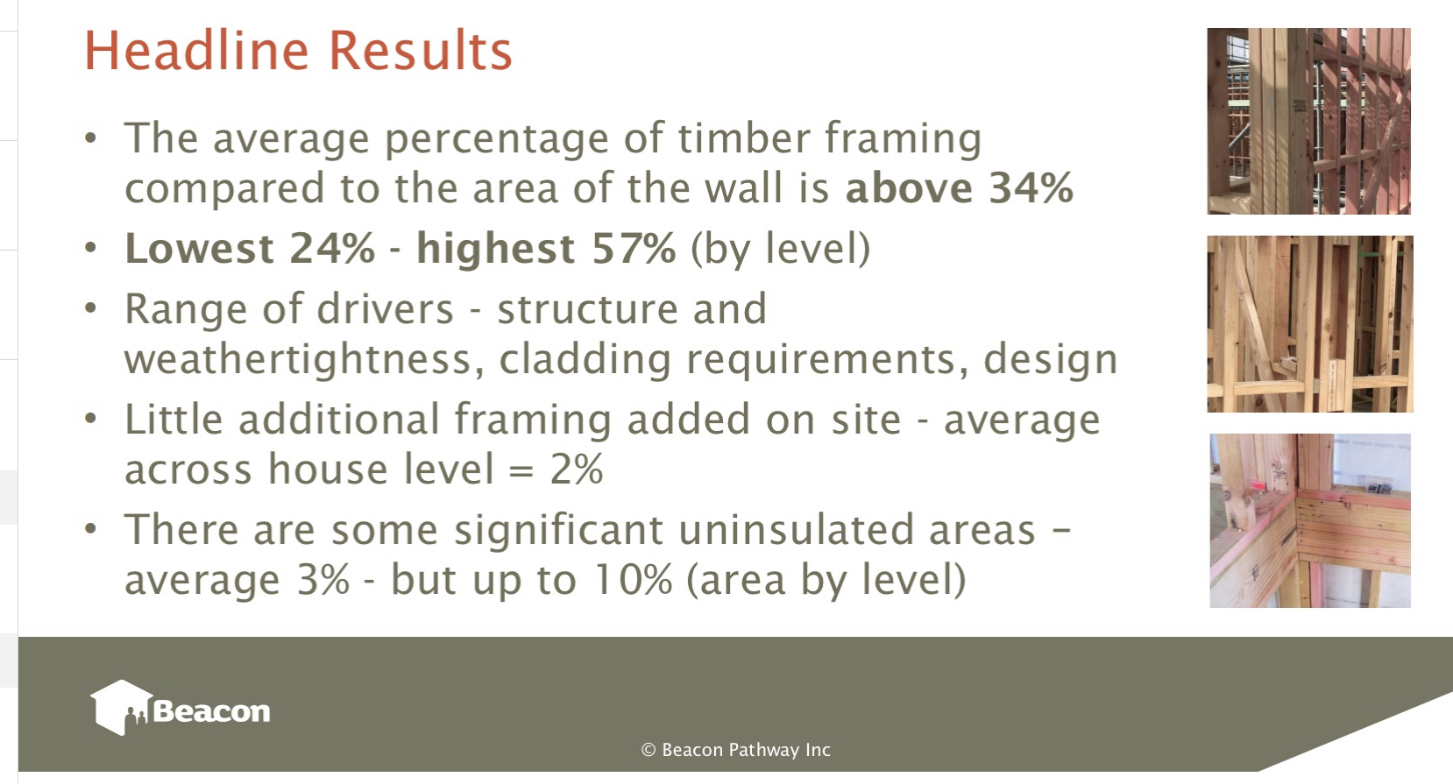

Slide 12
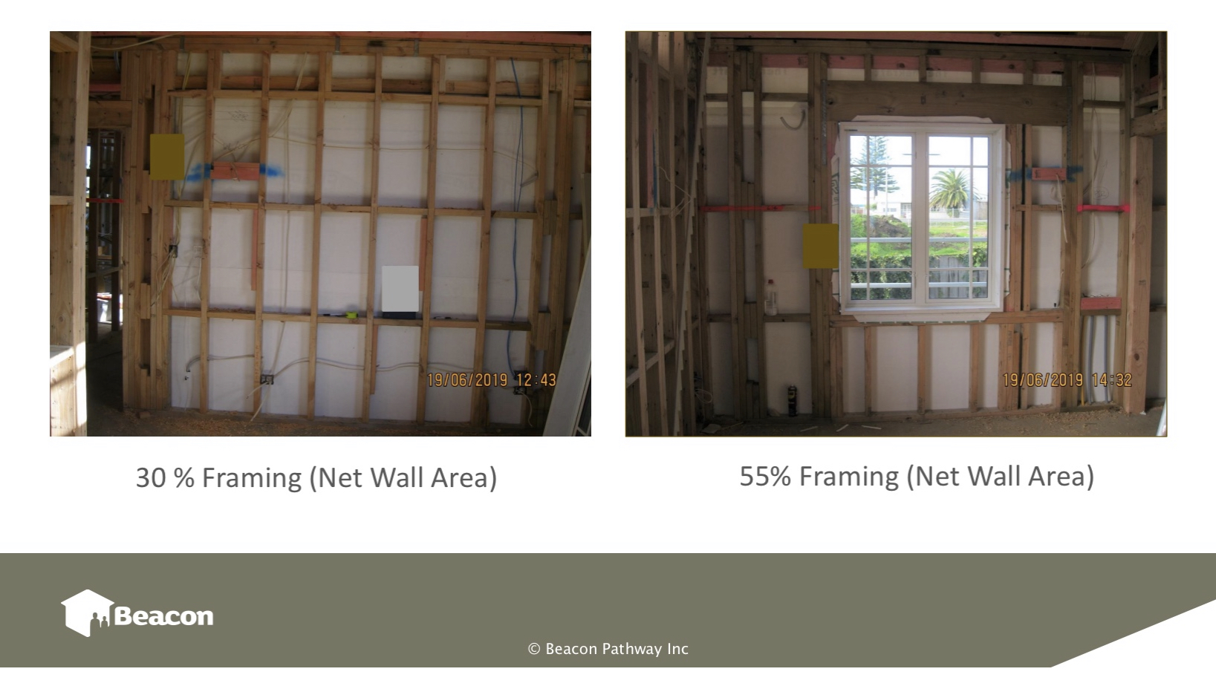

Slide 13
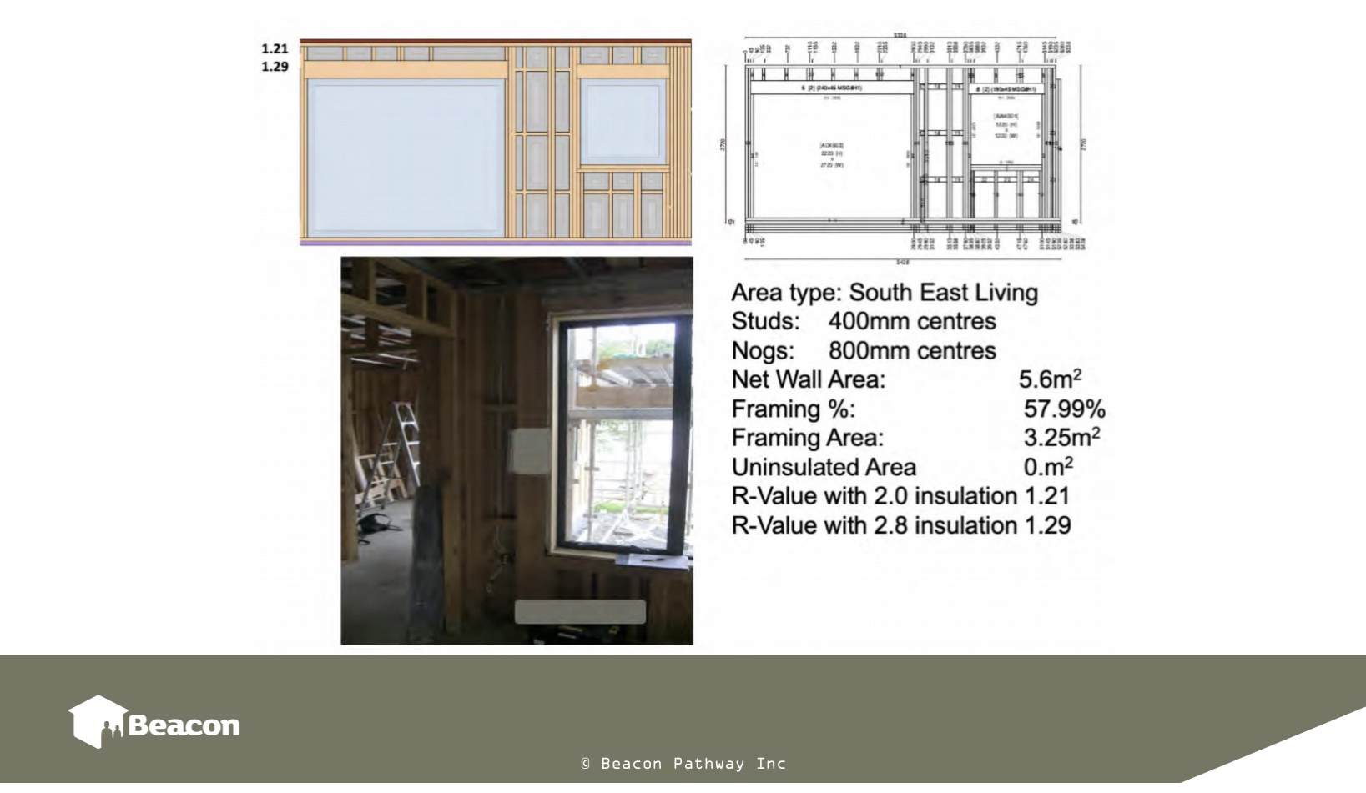

Slide 14
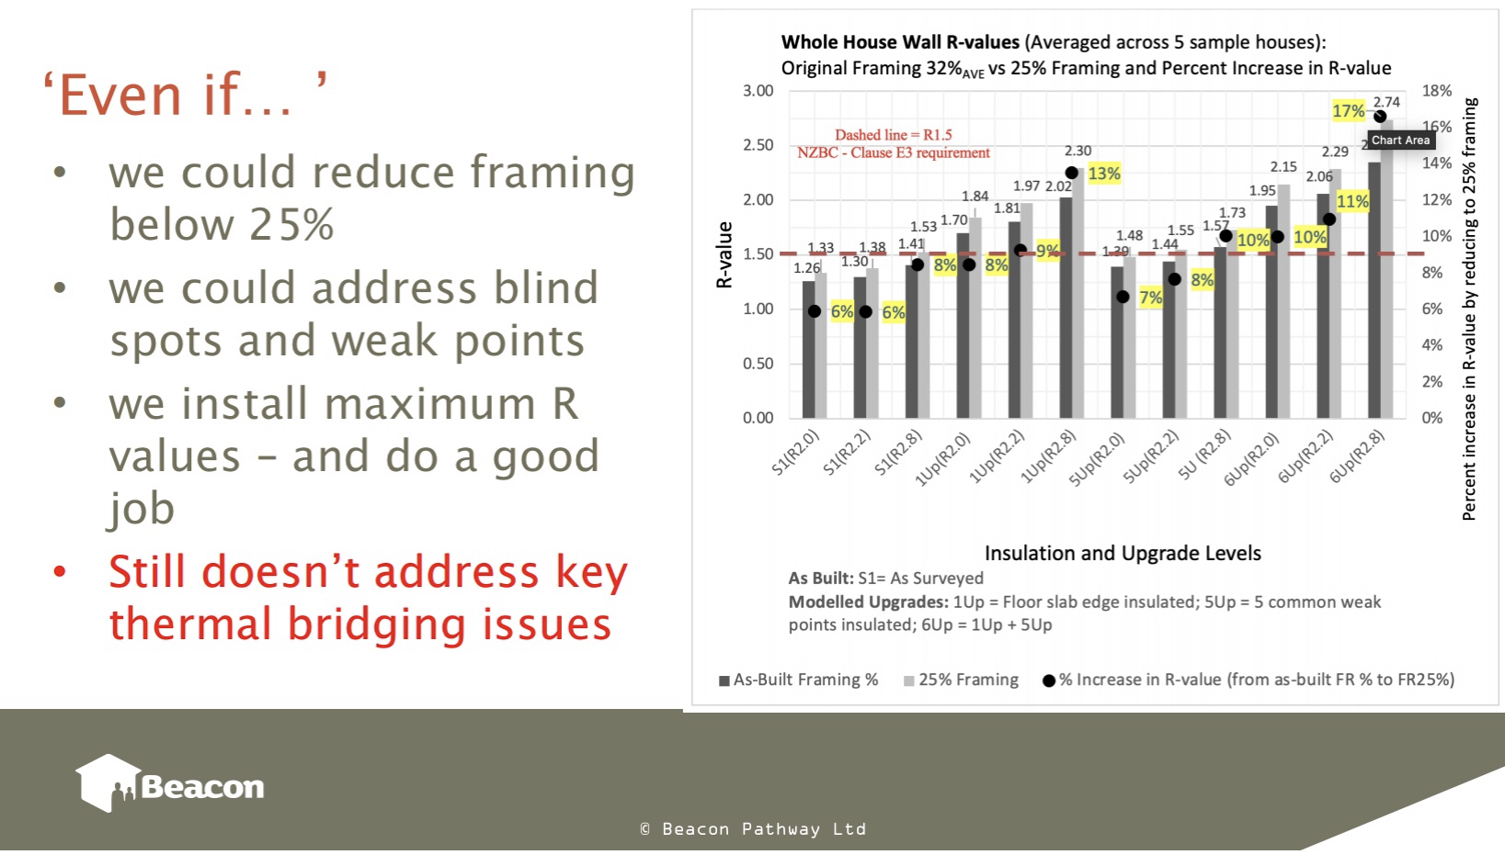

Slide 15
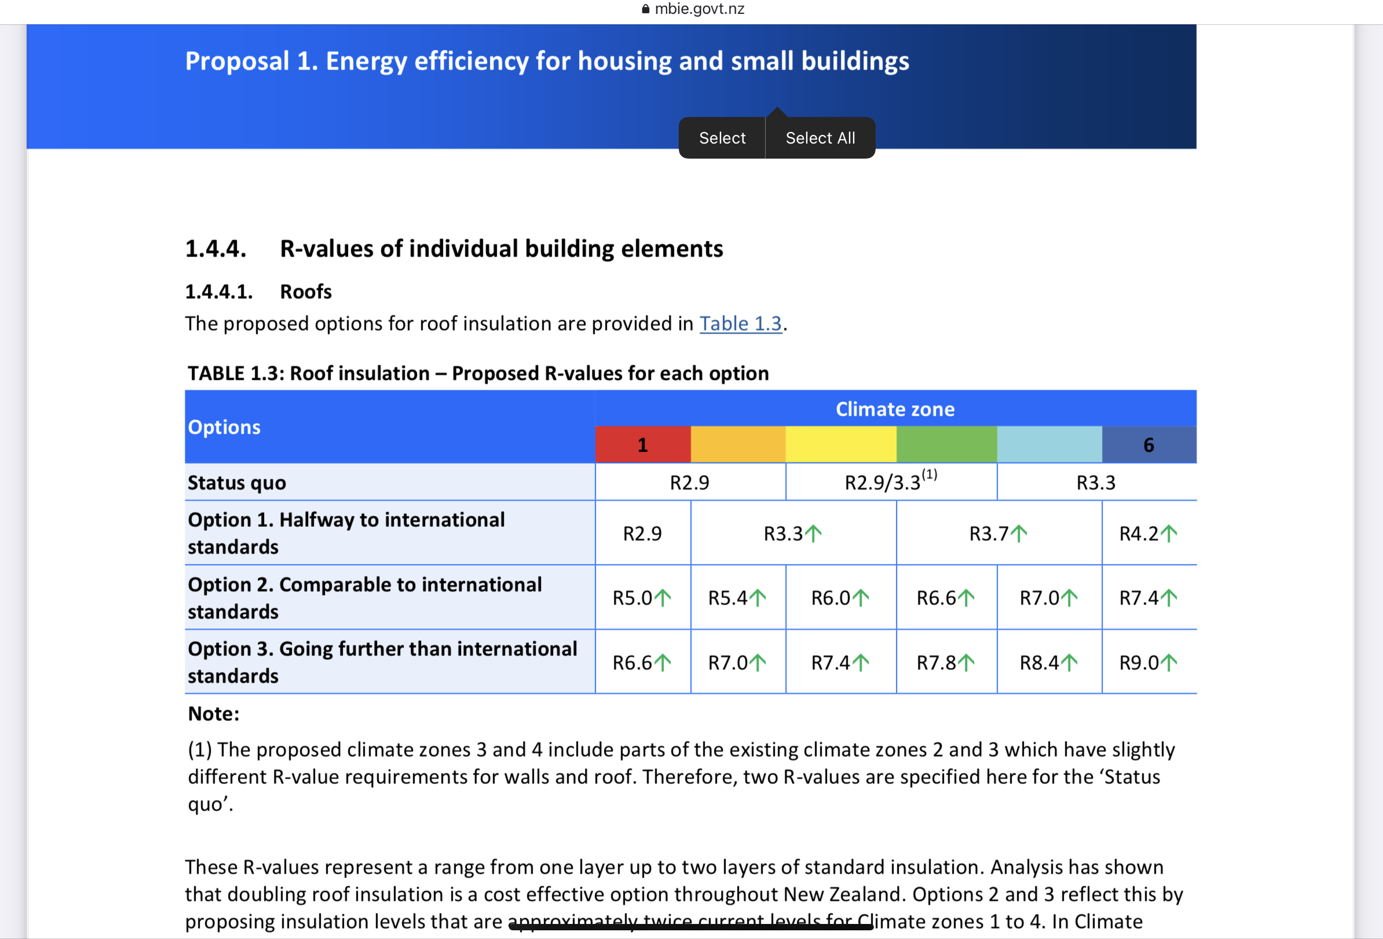

Slide 16
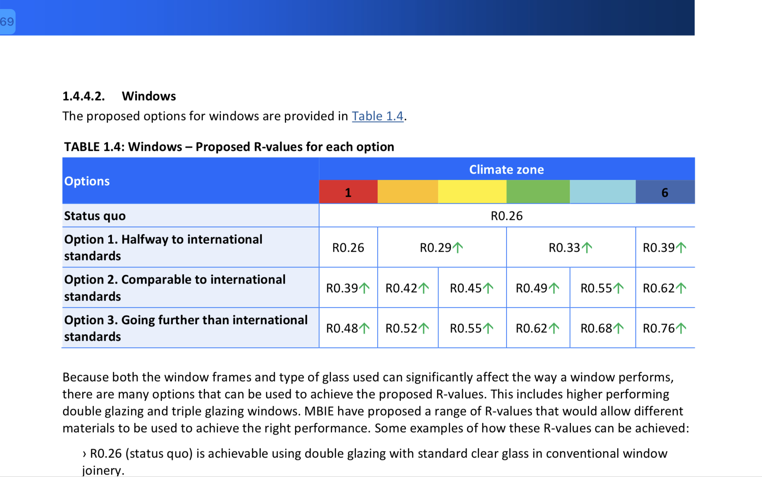

Slide 17
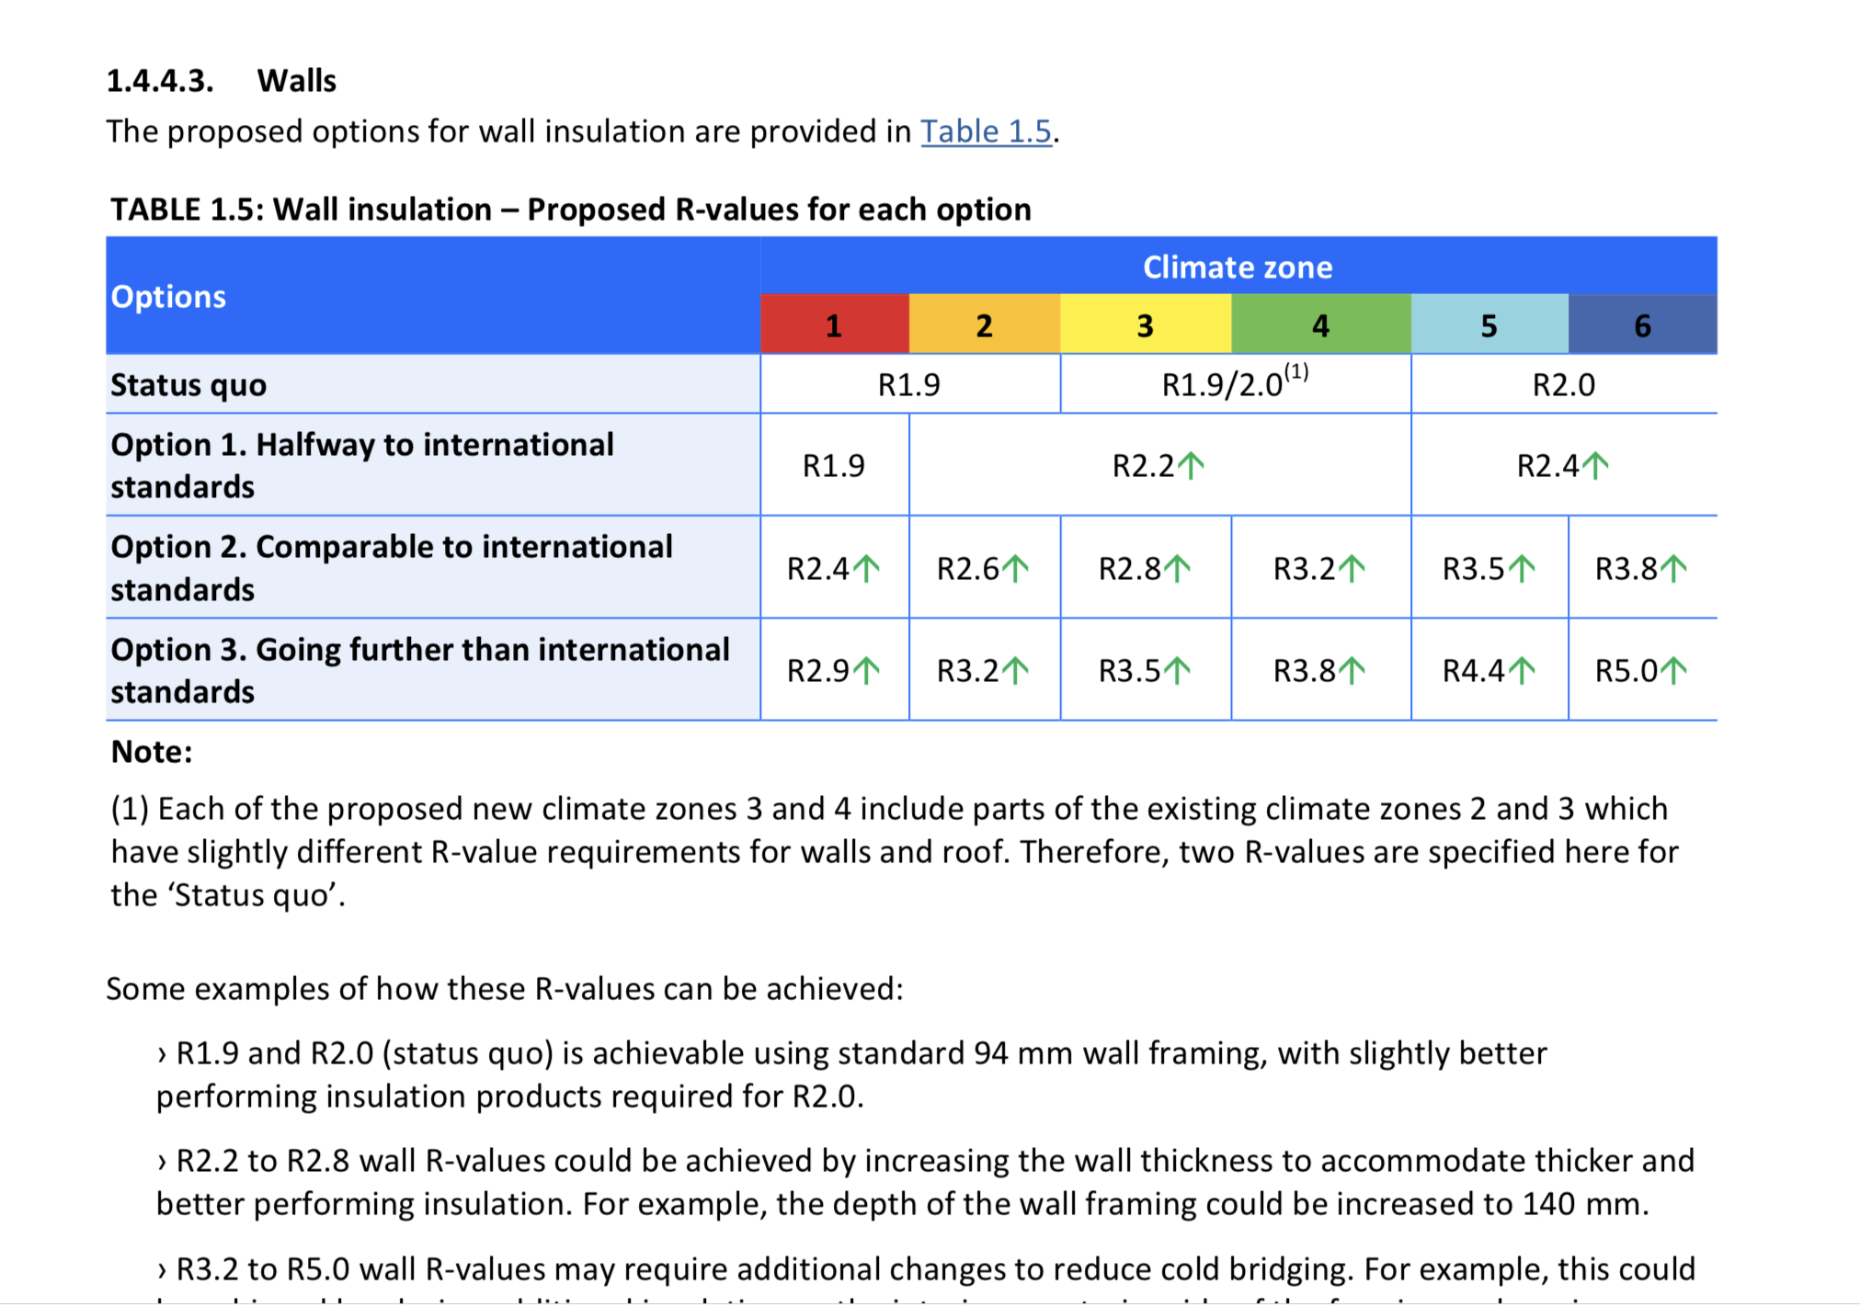

Slide 18
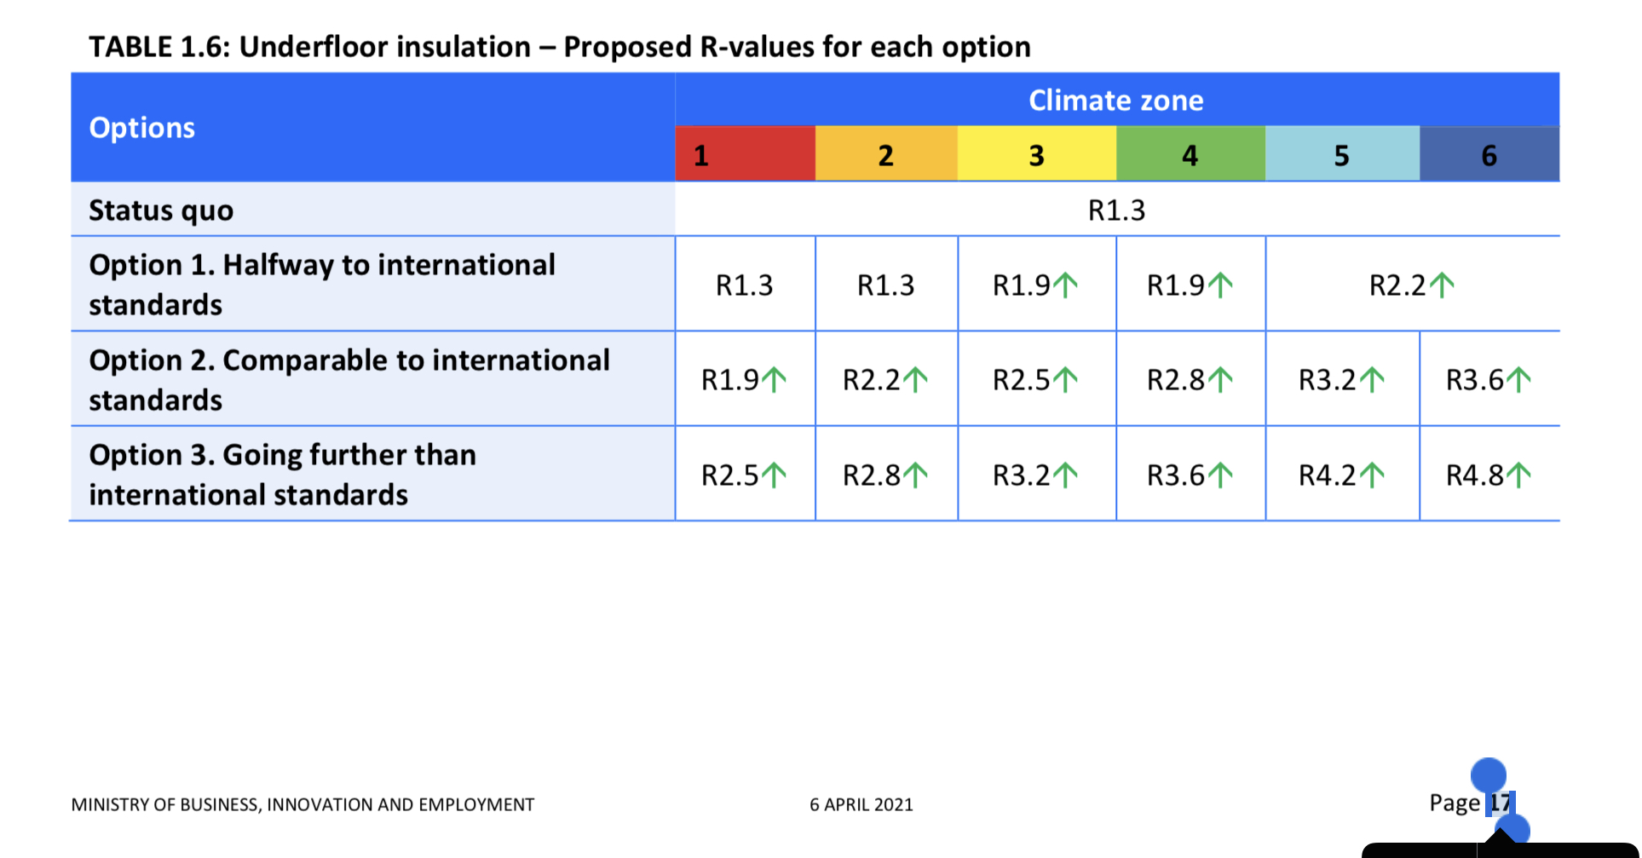

Slide 19
The Future ?
H1 changes to be announced soon
We can still do better, H1.2?
Carbon accounting , then reduction BfCC
H1 to align eventually with BfCC
Proper assessment of the thermal performance of residential buildings
Homes for New Zealanders that really do keep them warm and dry and don’t cost the earth !!!

Slide 20
Tools/ Check outs
BRANZ LCA Quick
Building for Climate Change
NZ Green Building Council
Passive House Institute NZ
Super Home Movement
Beacon Pathway
Eco Design Advisors

